Slide 1

Beautiful Bangladesh
Go to 3rd Slide

Slide 2

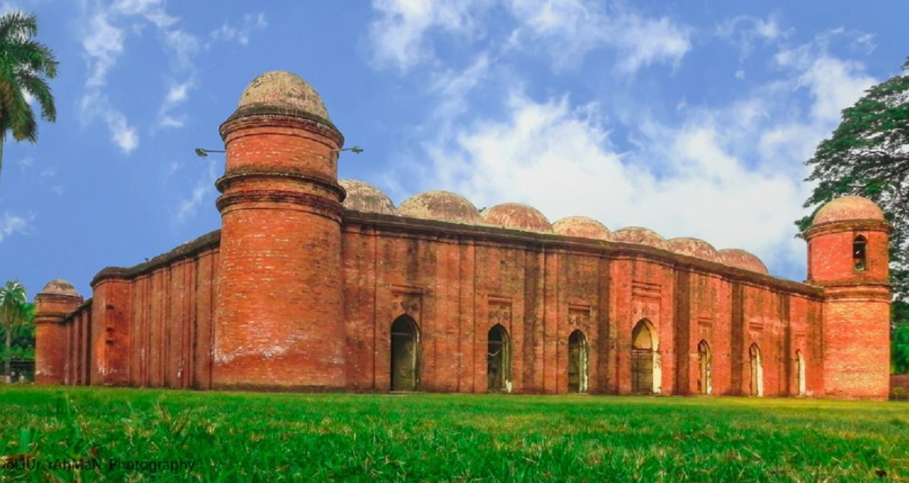
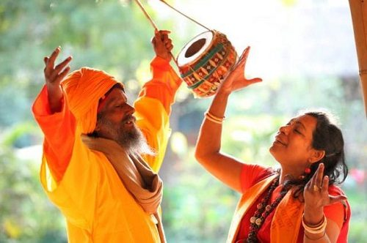
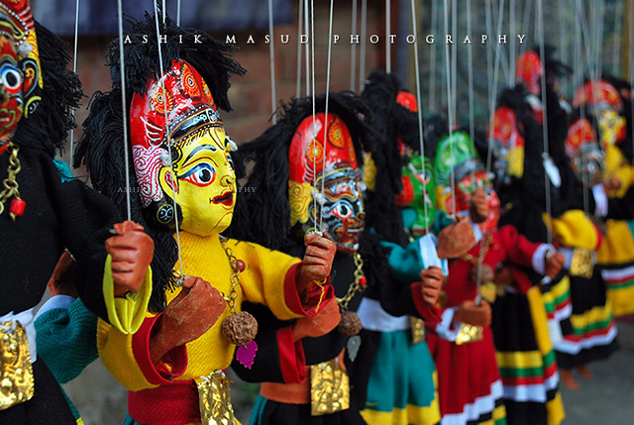
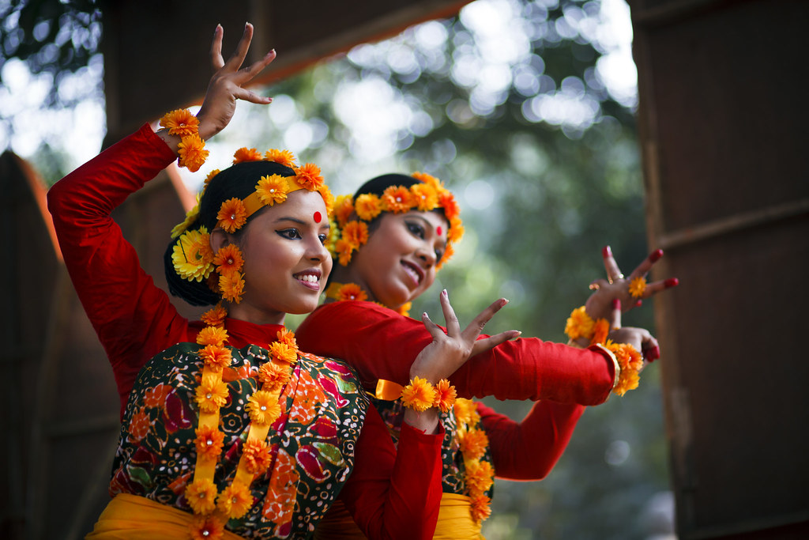
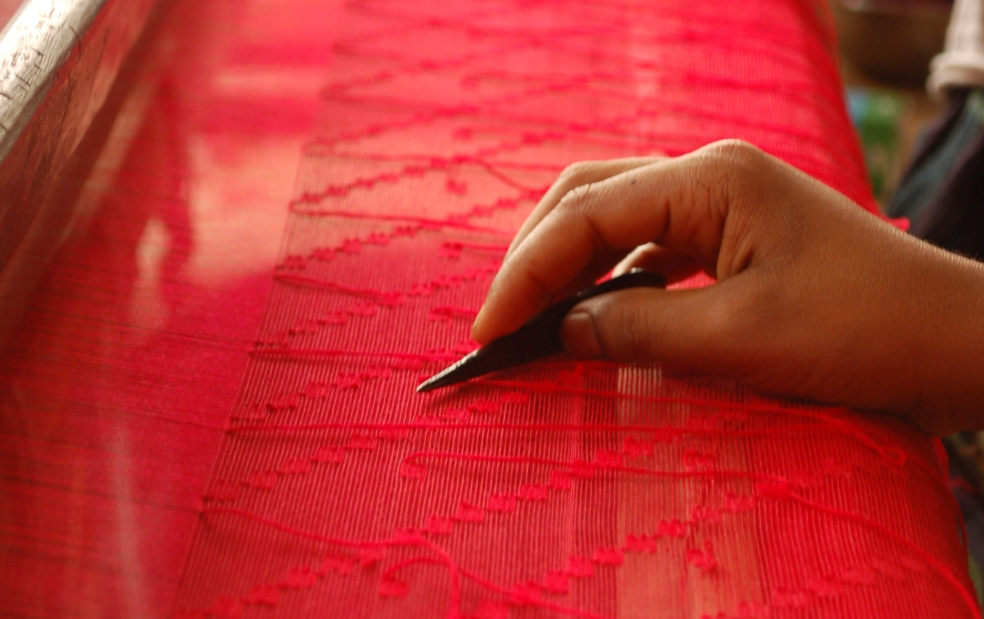
Sixty Dome Mosque
Baul Song
Putul Nach
Cultural Diversity
Jamdani
Go to 5th Slide

Slide 3


Sixty Dome Mosque
The Sixty Dome Mosque, also known as the Shaṭ Gombuj Masjid, is one of the most remarkable examples of Islamic architecture in South Asia and a UNESCO World Heritage Site. Located in Bagerhat, Bangladesh, the mosque was built in the 15th century by the Turkic general Khan Jahan Ali, who founded the city.

Slide 4

Baul Song
Baul songs are a UNESCO-recognized intangible cultural heritage of Bangladesh, representing the mystical and spiritual traditions of the Baul community. These songs focus on themes of love, humanity, and the quest for the divine within oneself.

Slide 5

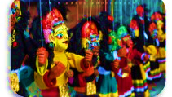
Putul Nach
Putul Nach, or traditional puppet dance, is a cultural heritage of Bangladesh that combines storytelling, music, and puppetry to depict folklore and social themes. This vibrant art form preserves the rich traditions of rural Bengali entertainment.

Slide 6

Cultural Diversity
Bangladesh's cultural diversity is reflected in its rich tapestry of traditions, languages, and arts, shaped by its multi-ethnic communities and historical influences. From music and dance to festivals and crafts, this diversity unites the nation's identity.

Slide 7

Jamdani
Jamdani, a UNESCO-recognized intangible cultural heritage of Bangladesh, is a traditional handwoven fabric known for its intricate designs and fine craftsmanship. This centuries-old art reflects the country’s rich textile heritage and cultural identity.

